Slide 1
Modular Distributed Ammonia Synthesis
Riley Barth & Hunter Violette
Notes:
Our design project was modular distributed ammonia synthesis
- Ammonia synthesis.
o Very important precursor to different fertilizers such as ammonium nitrate, urea, and ammonium phosphate.
§ 40% of worlds ammonia supply is converted to Urea`
§ In 2015, 3.5 billion / 7.3 billion were fed by synthetic fertilizers
o Also used as a precursor to nitric acid, hydrogen cyanide, and various types of plastics
- Distributed so production doesn’t have to be at a single location
o Majority of USA ammonia supply is in gulf host with NG.
o The farther away you live from gulf cost the more you have to pay for transportation
§ Ammonia can benefit greatly from a distributed process because ammonia itself is extremely dangerous and therefore expensive to transport.
·
§ Depending on how many metric tons needs to be transported a year, a distributed approach can become much more viable.
- Modular designs allow significant more flexibility to scale with demand or profitability than a conventional plant

Slide 2
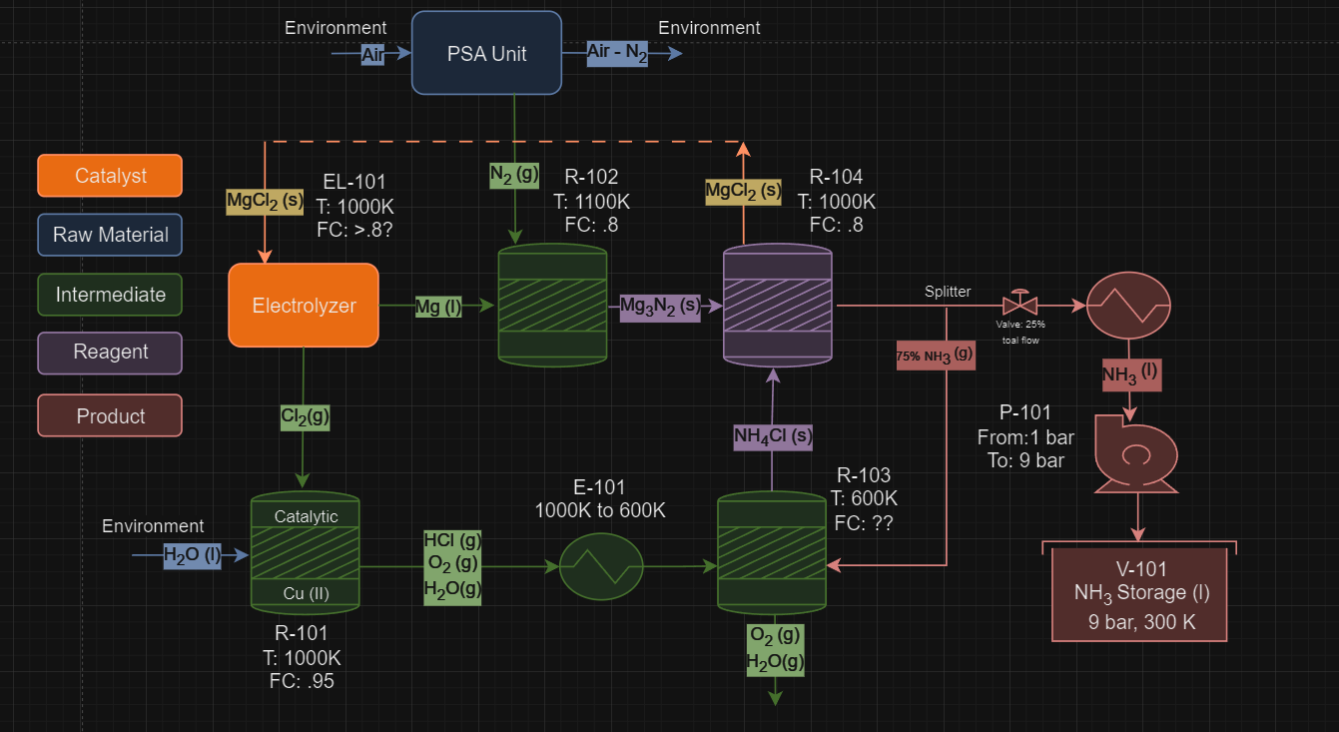
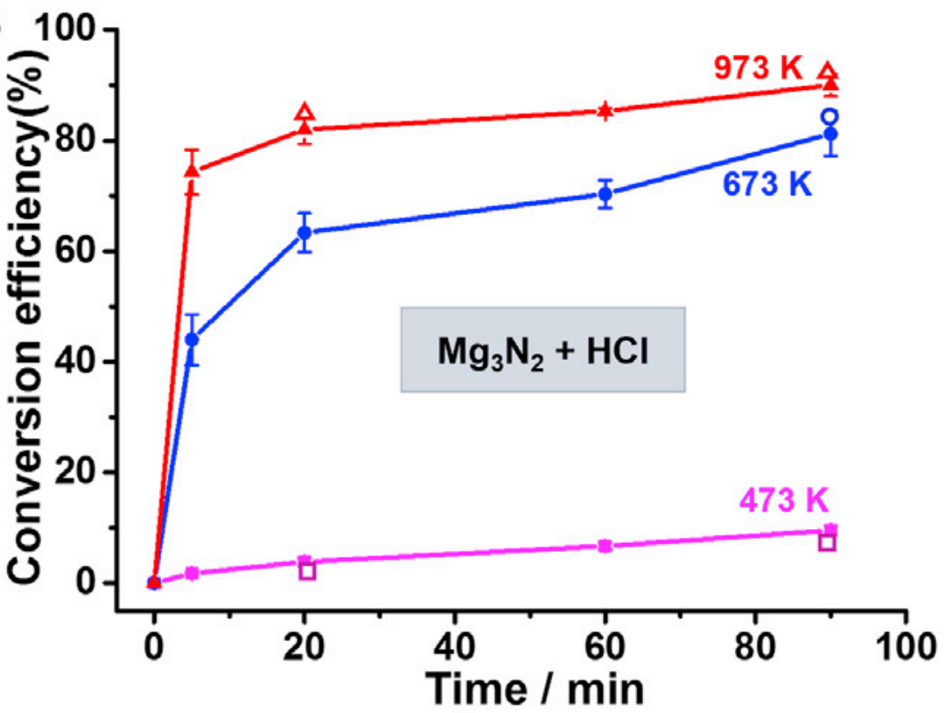
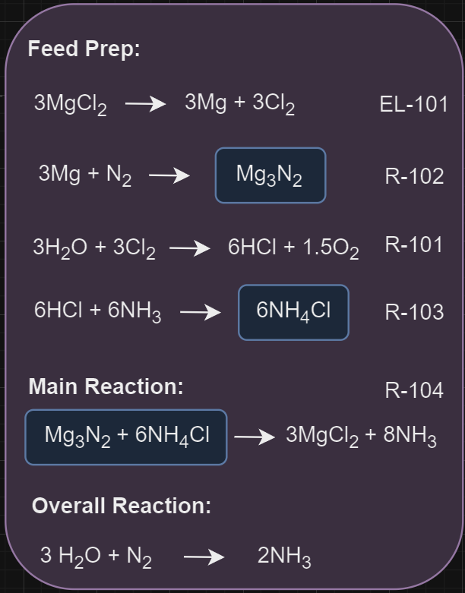
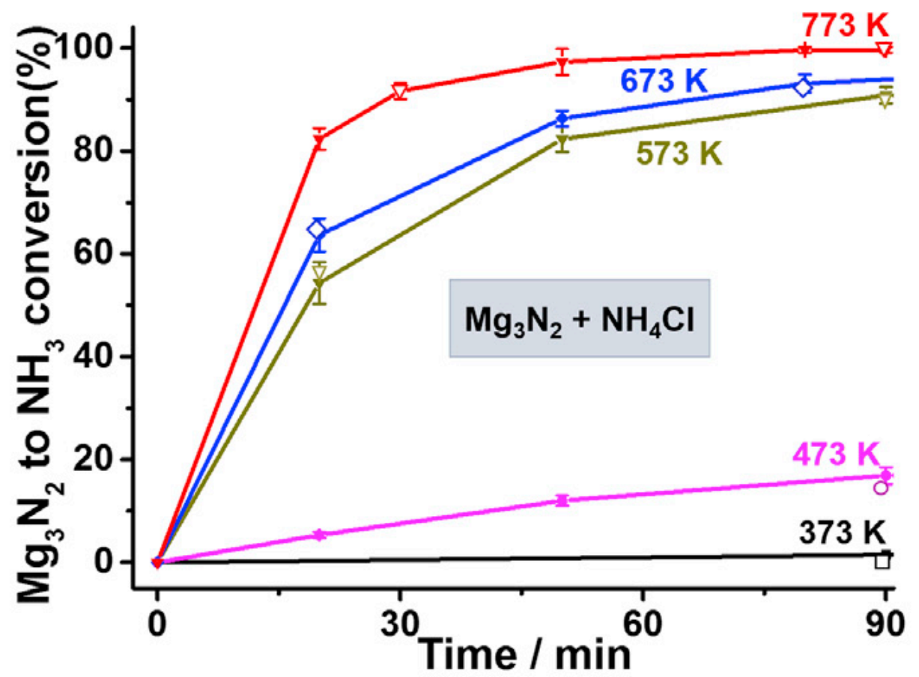
Notes:
This was our first version of our process based on our chosen reaction pathway. The reaction pathway described in the main paper did electrolysis of MgCl2.
After splitting it, magnesium reacts with pure nitrogen to make Mg3N2
And the chlorine reacts with water to form hydrochloric acid
After making hydrochloric acid, it is reacted to make ammonium chloride
Solid ammonium chloride and solid magnesium nitrate regenerate solid magnesium chloride and gaseous ammonium
The stoich of the main reaction is:
1 Mg3N2 + 6 NH4Cl -> 3MgCL2 + 8NH3
After performing a steady state material balance, it was obvious that at the scale of ammonia we were producing (2mtpd), the size of the main reactor was huge due to the of the 8 moles of Nh3 we are producing, 6 is from ammonium chloride.

Slide 3
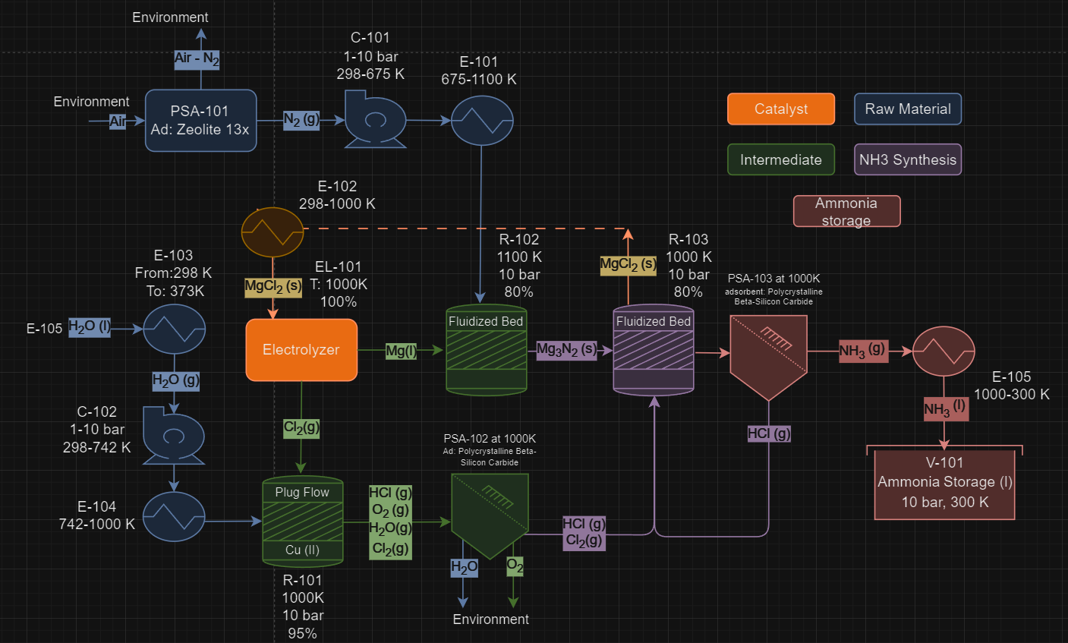
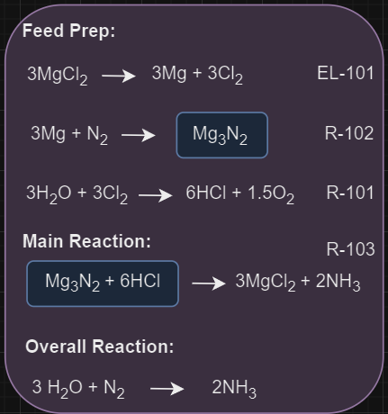

Slide 4
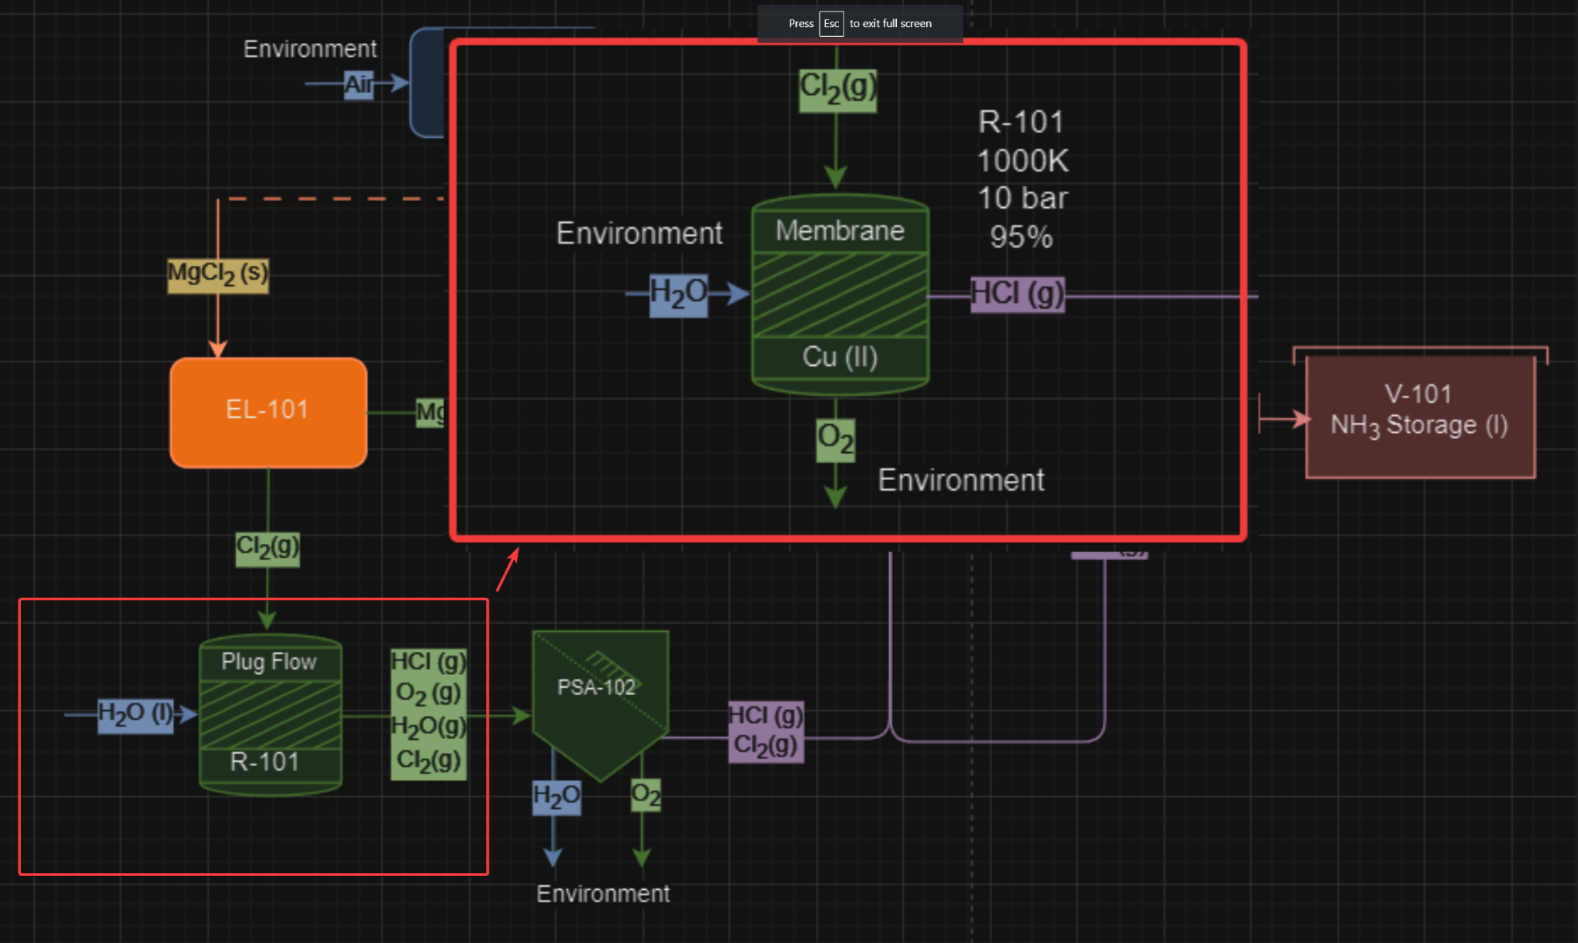
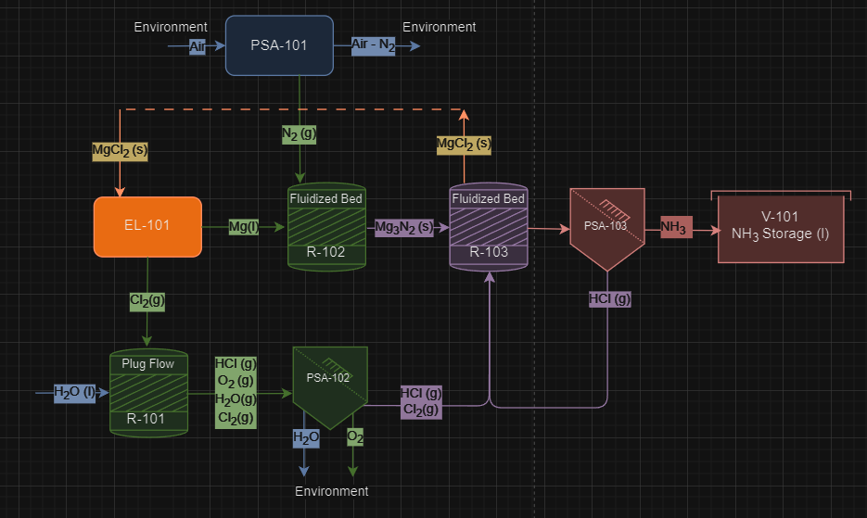
Notes:
Another possible upgrade is to use a catalytic membrane reactor instead of a plug flow reactor. If we could manage to get polycrystalline beta-silicon carbide as an adsorbent inside the reactor, we could generate anhydrous Cl2, and avoid needing to buy PSA 102.

Slide 5
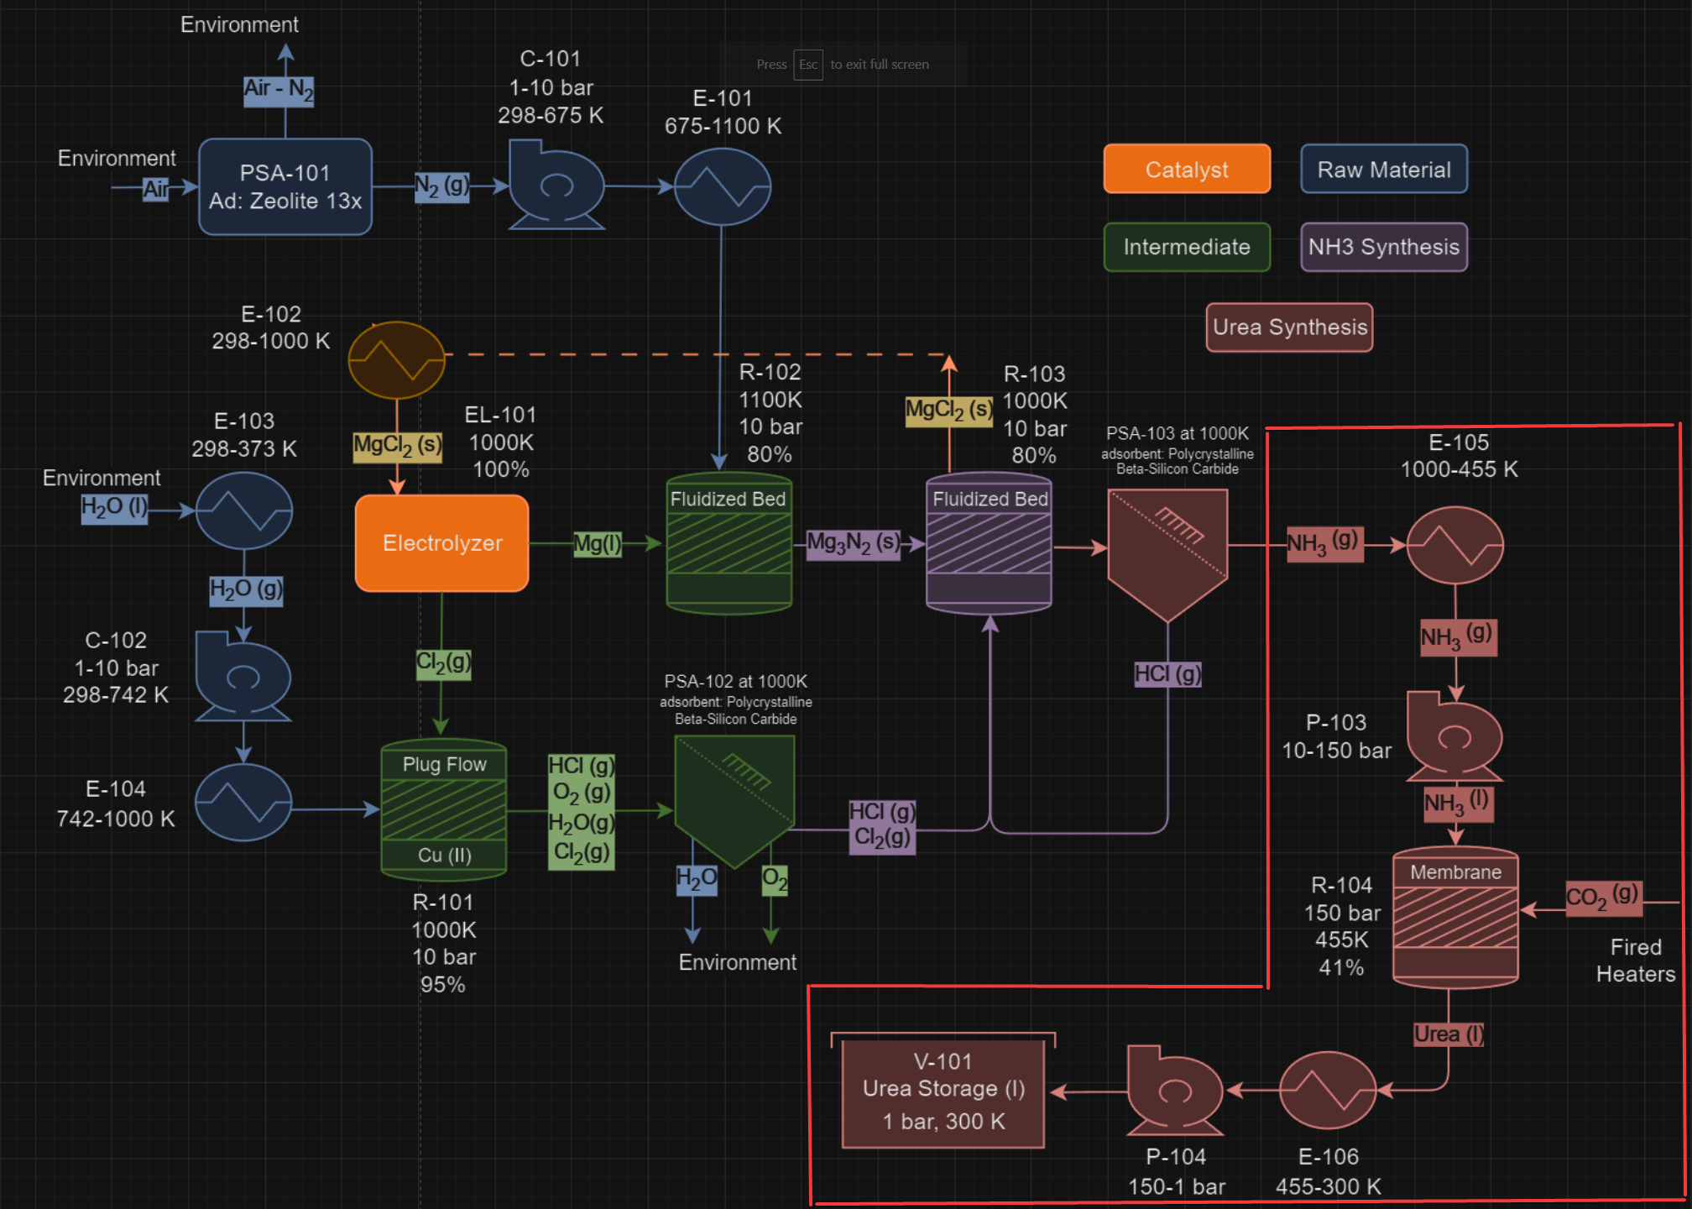
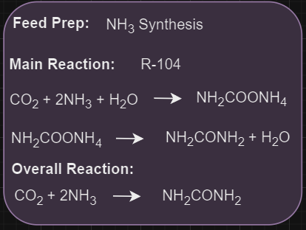
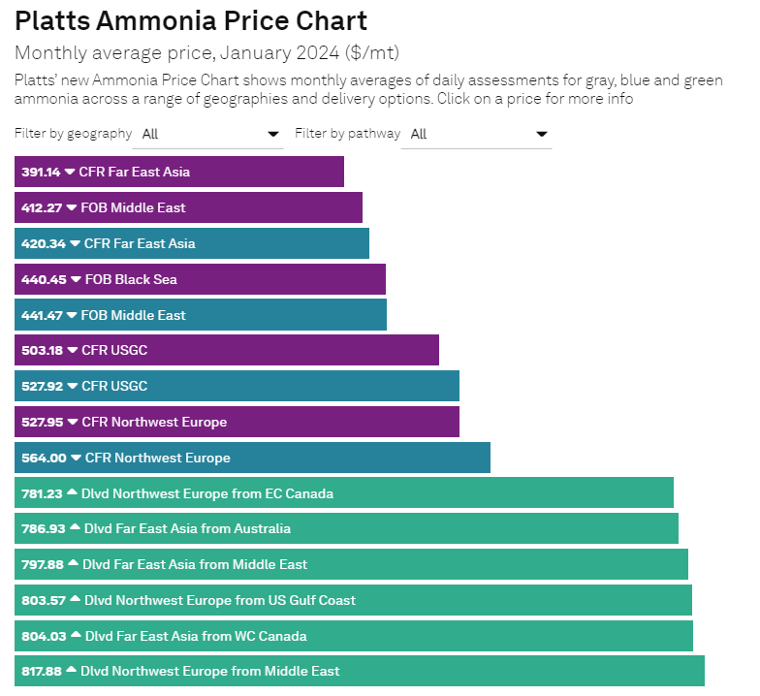
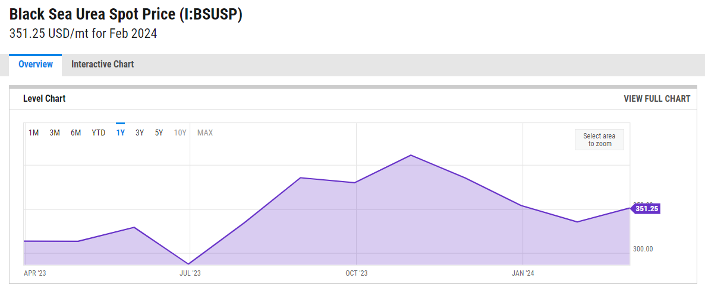
Notes:
40% of the world’s ammonia is converted into urea, as urea is safer and easier to store. Ammonia is typically stored in a pressurized and sometimes refrigerated tank, while urea is a solid and doesn’t require any special storage conditions. Producing urea could reduce safety issues during production, transportation, and to the end user.

Slide 6
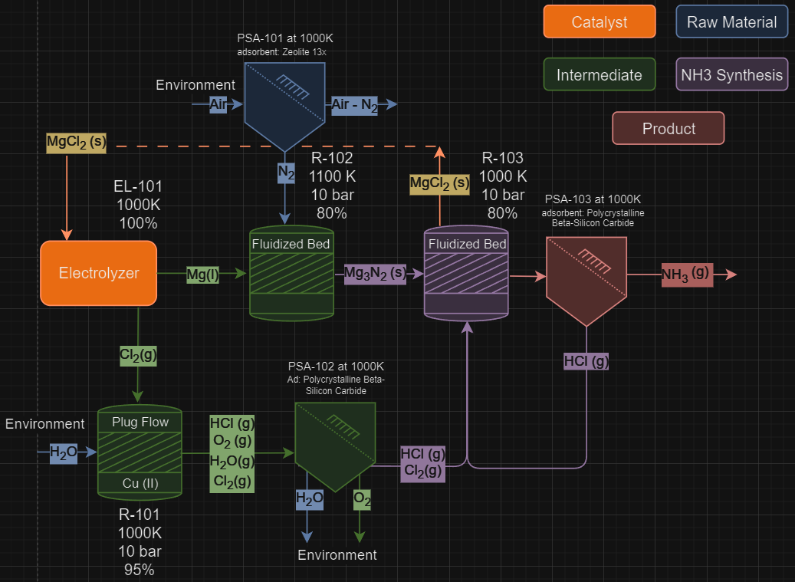
Notes:
This is the process we decided to simulate for our base case. The first objective was to calculate the non steady state material balance.

Slide 7
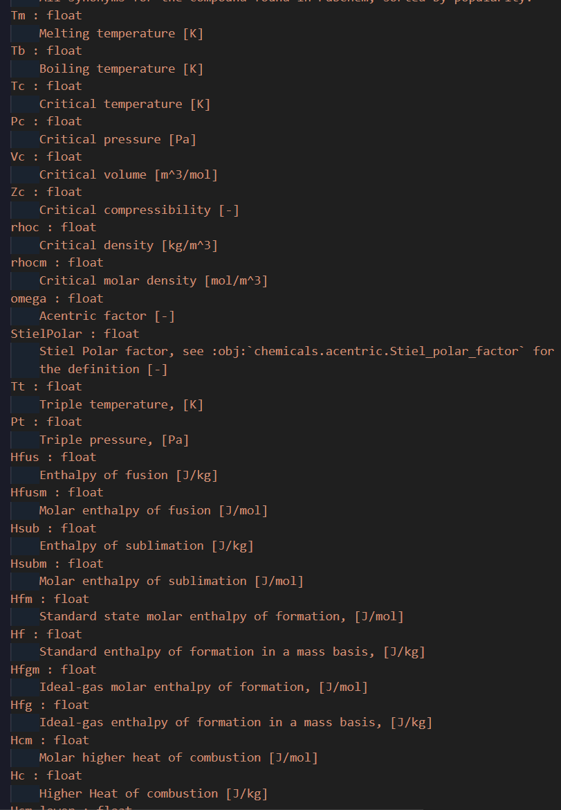
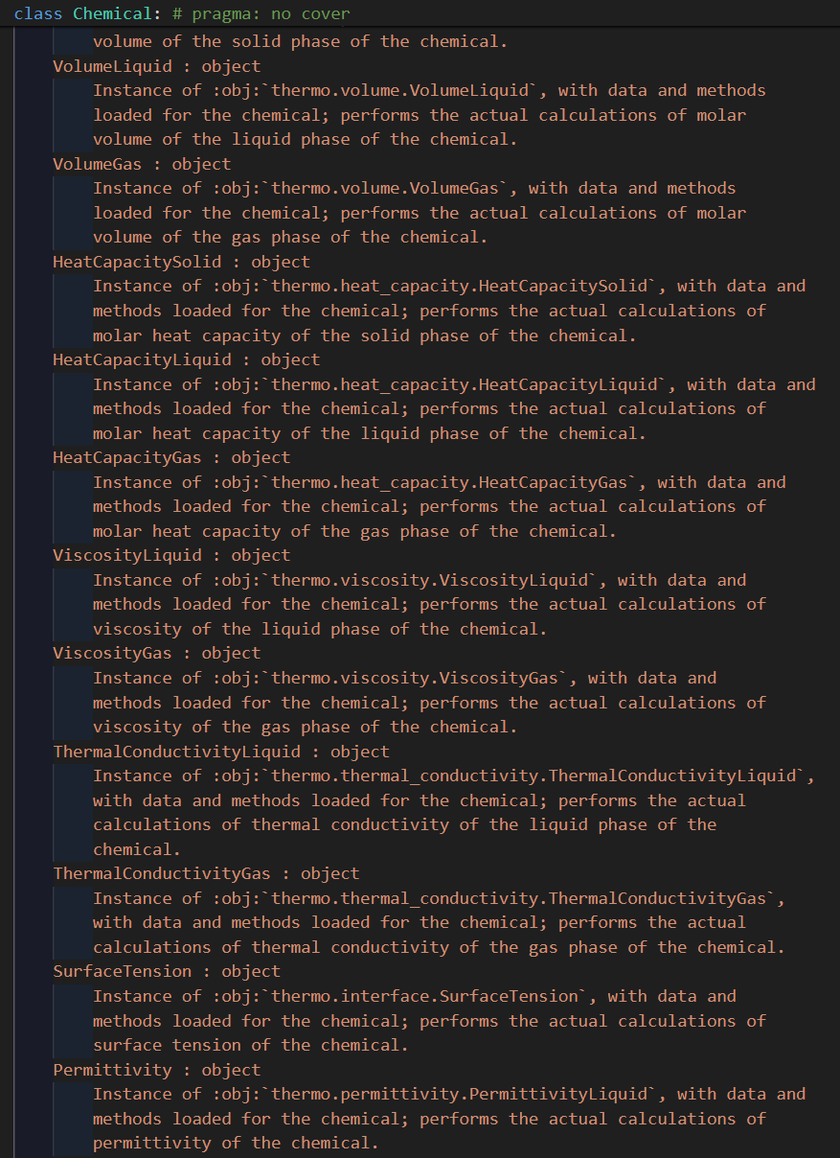
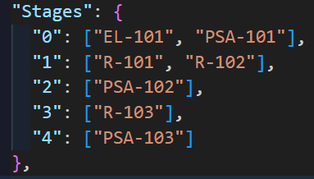
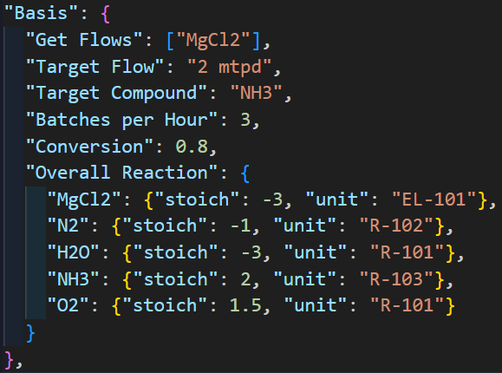
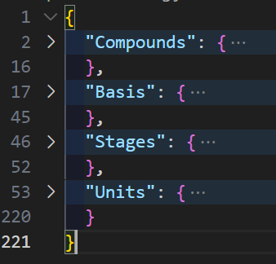
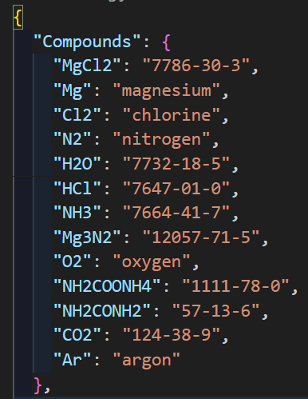
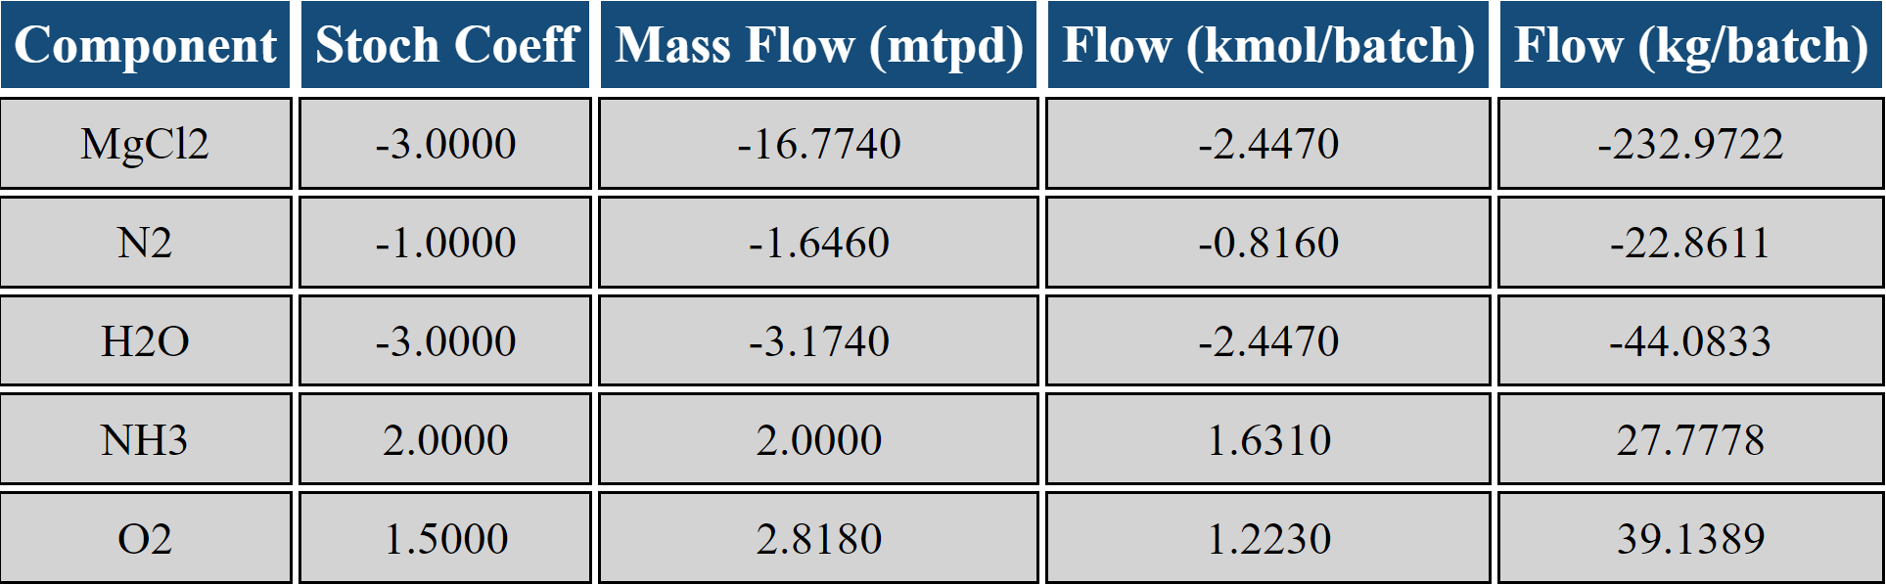

Slide 8
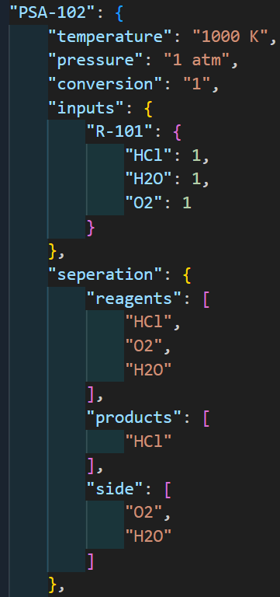
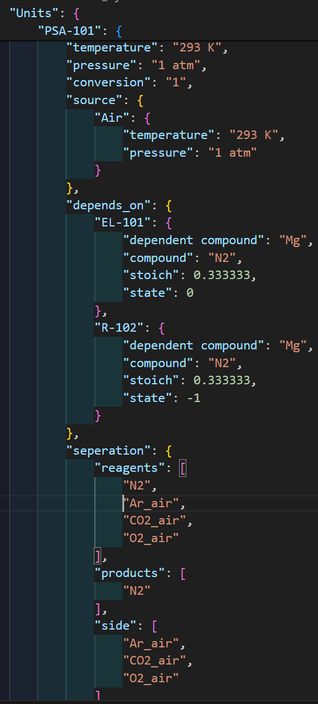
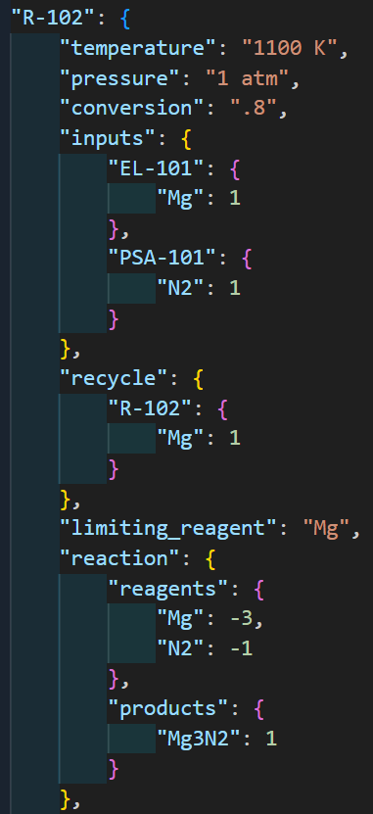
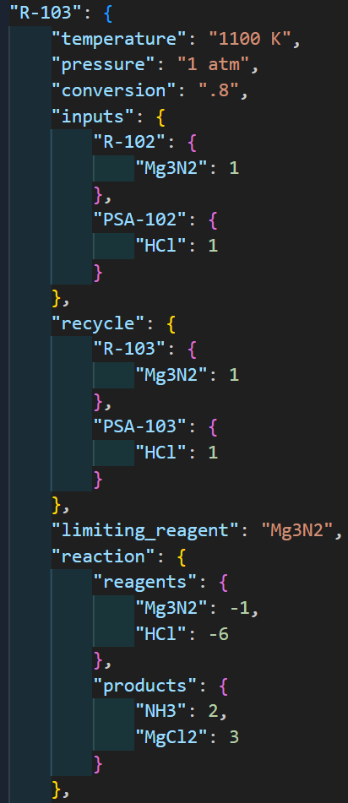
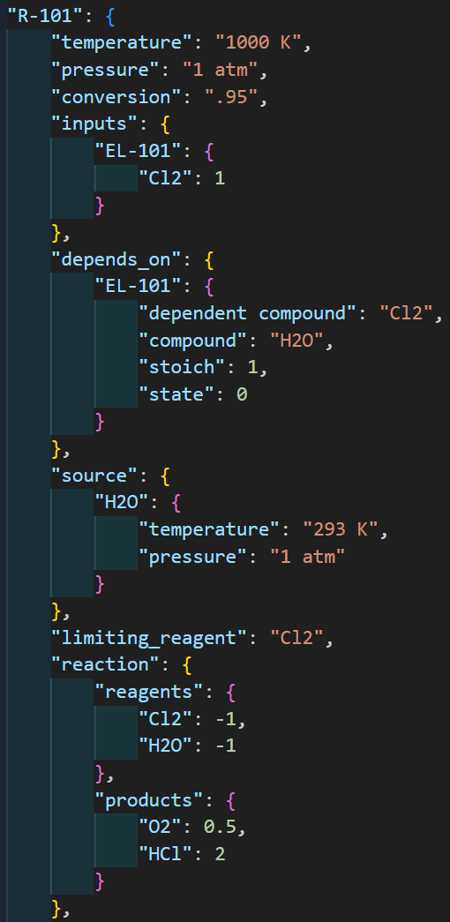
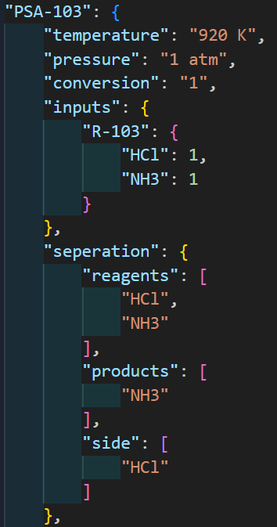
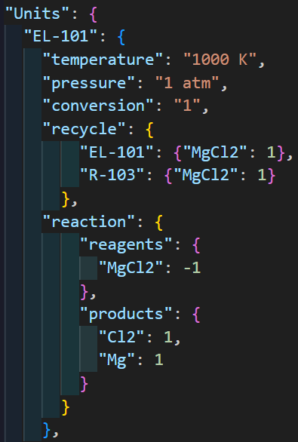
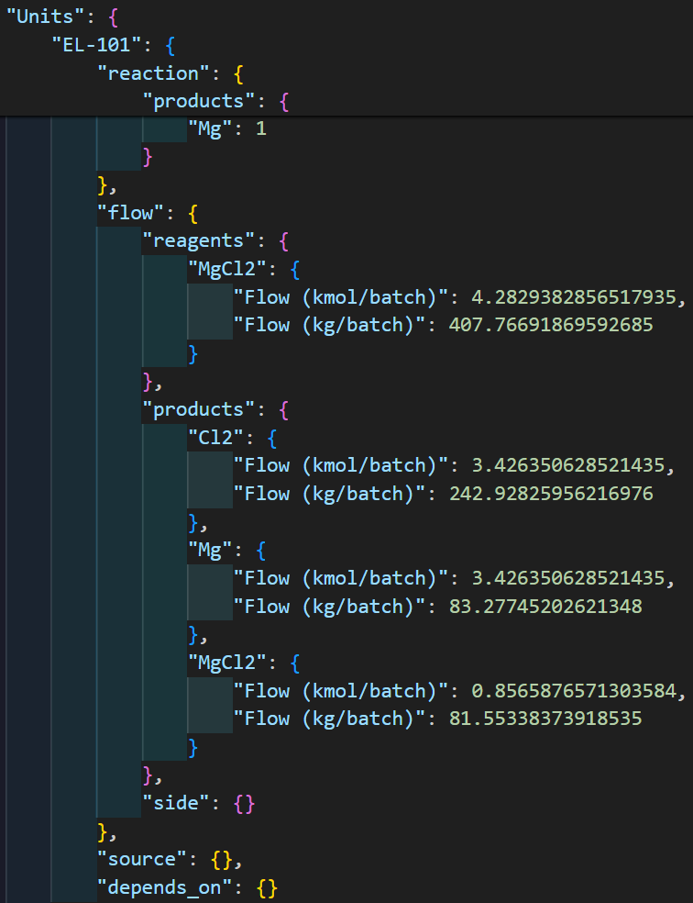

Slide 9
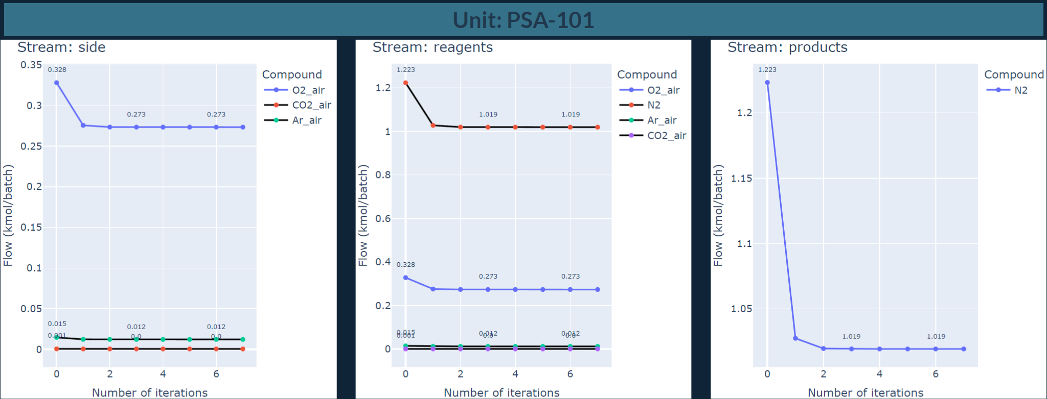
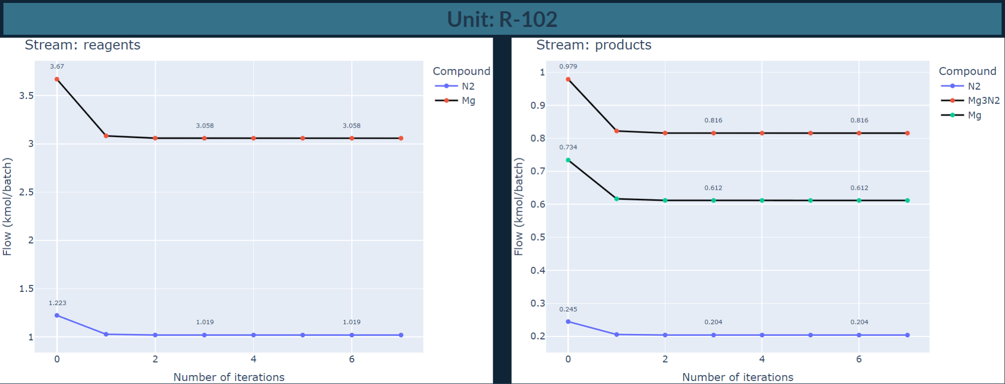
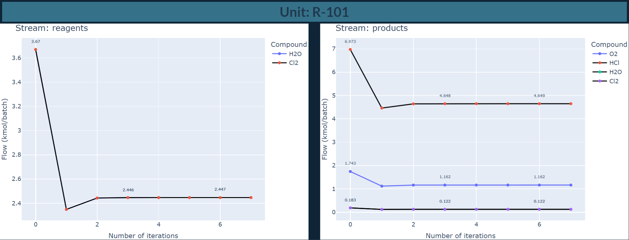
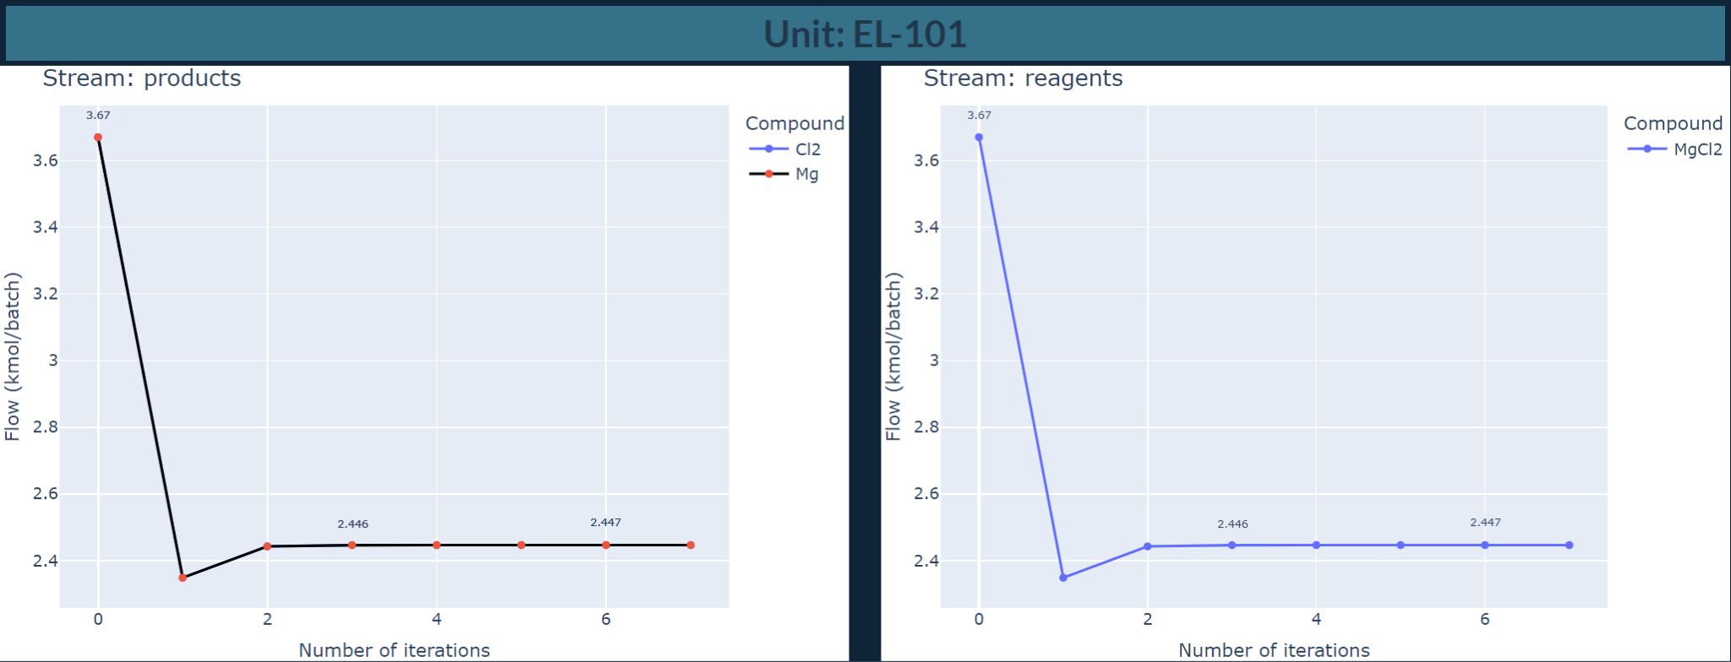
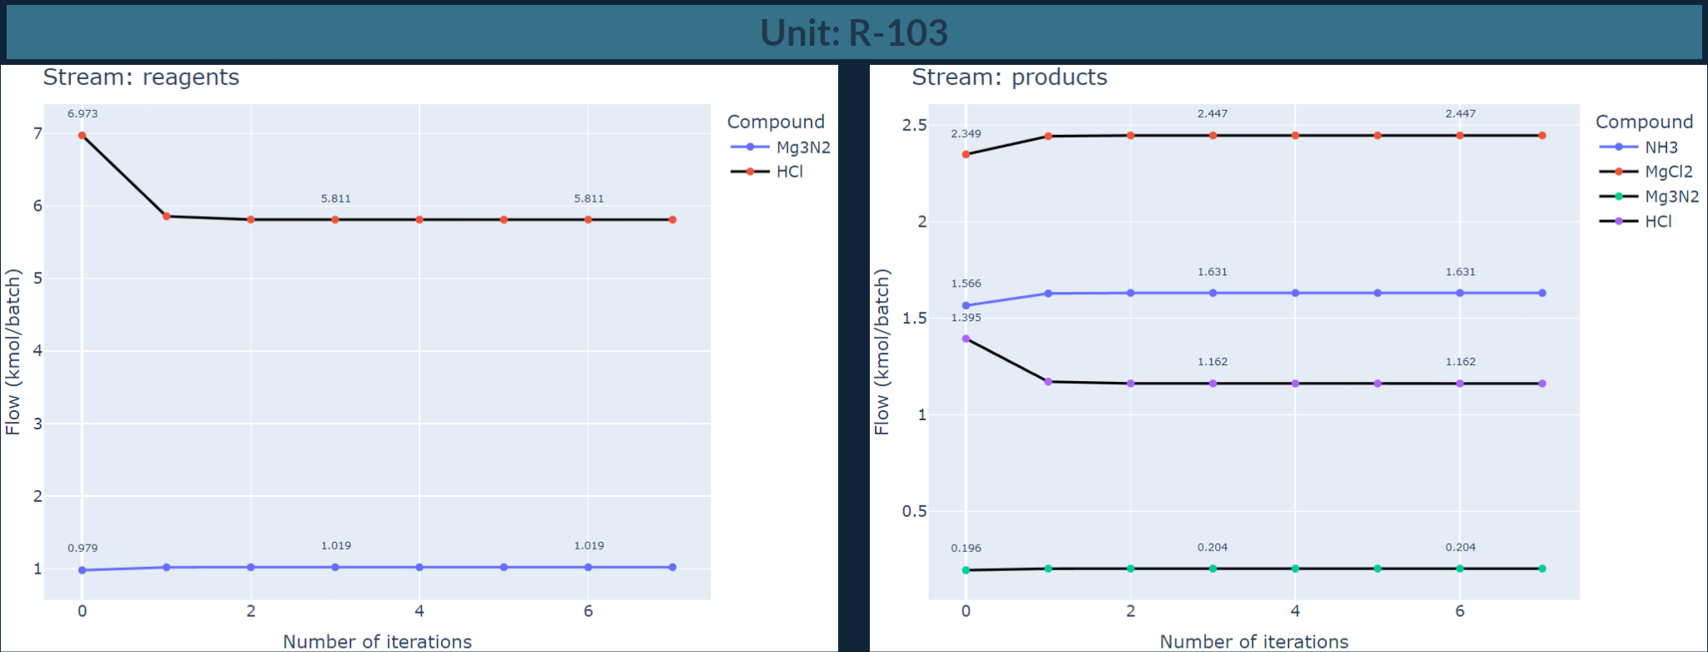
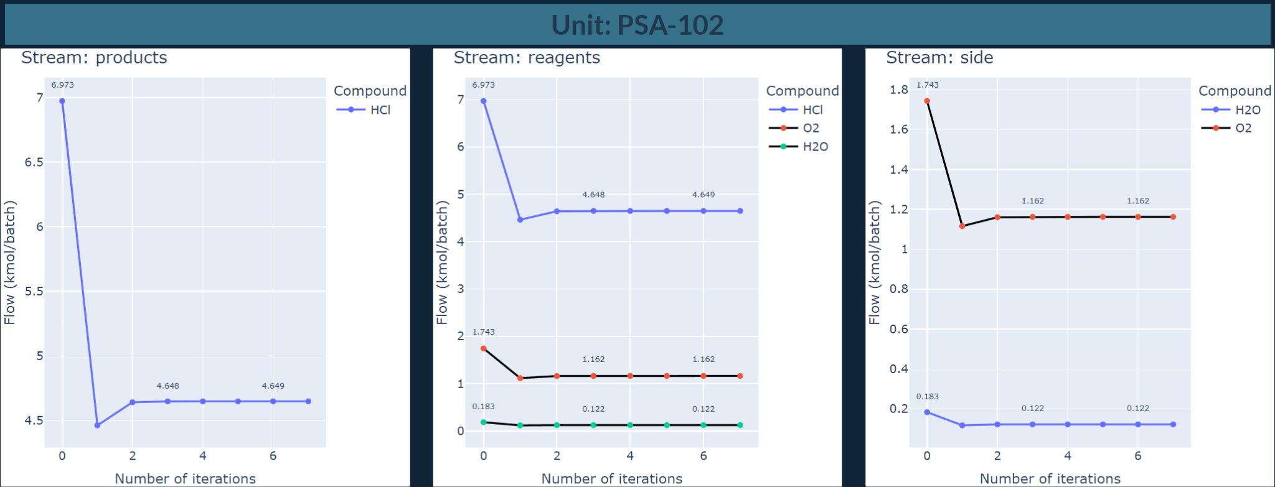
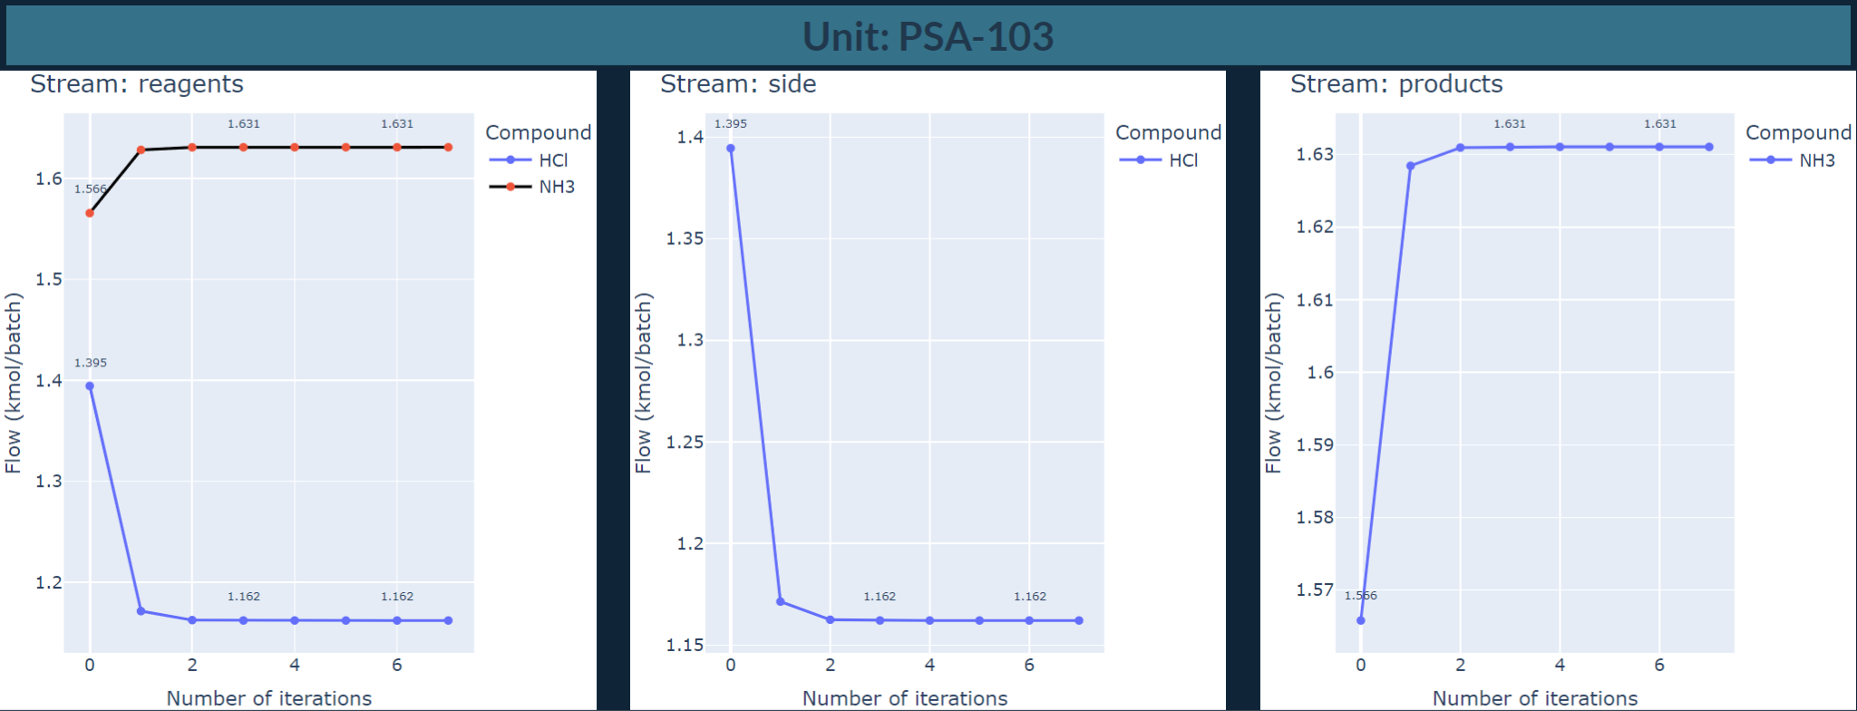

Slide 10
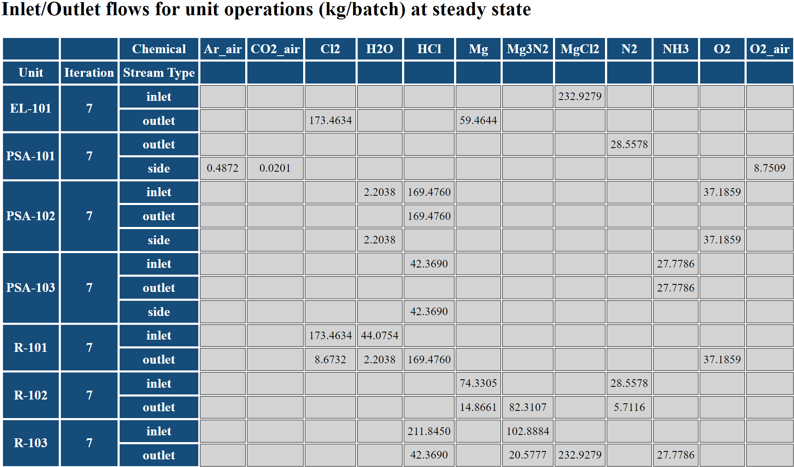
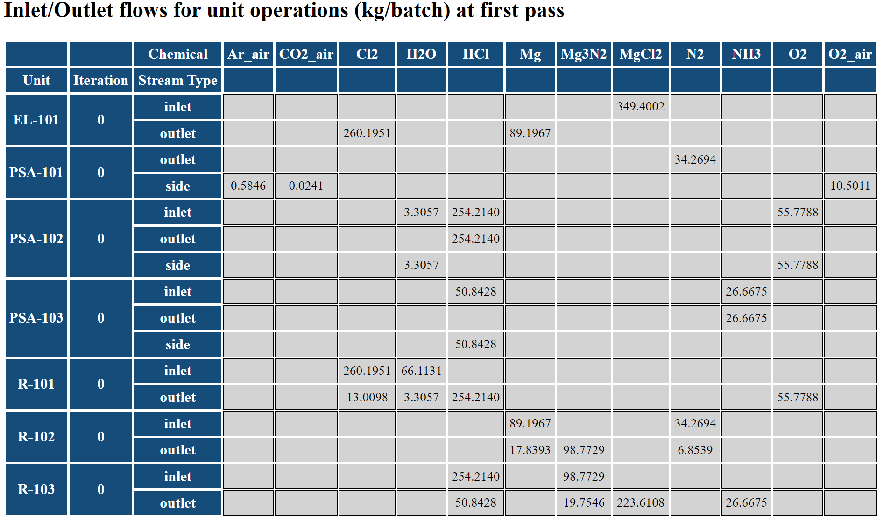

Slide 11
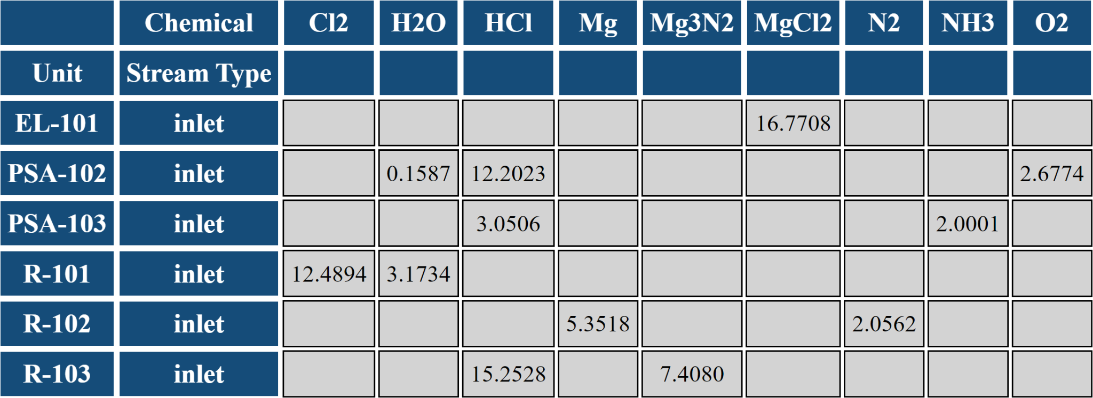
Inlet Flows at Steady State (mtpd)

Slide 12
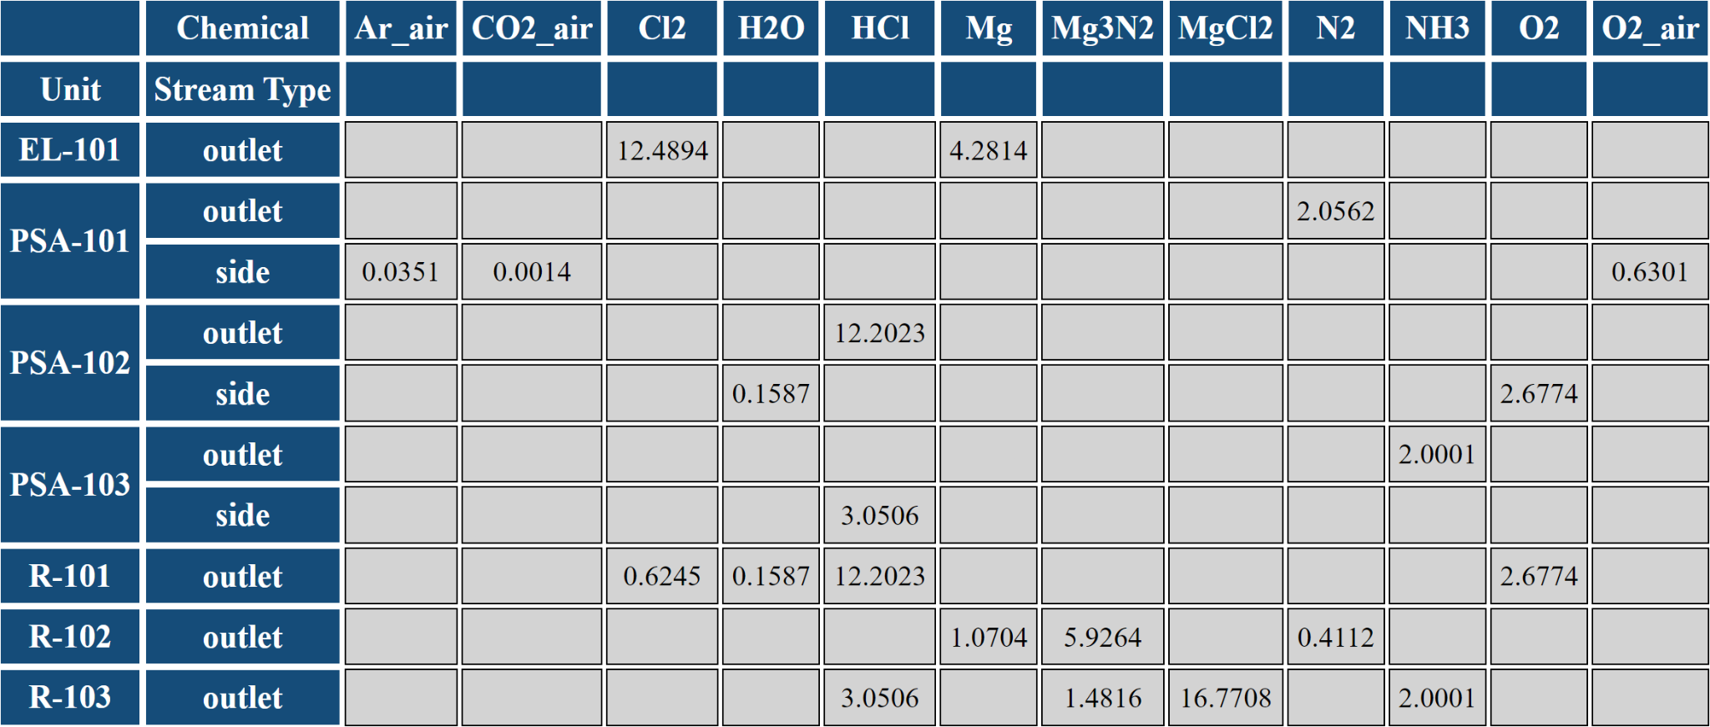
Outlet Flows at Steady State (mtpd)

Slide 13
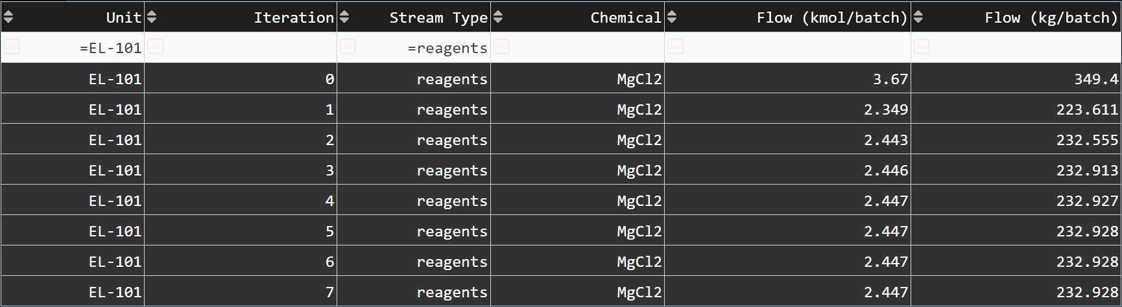
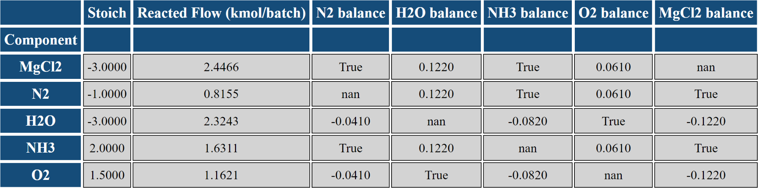
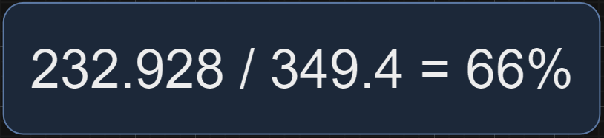
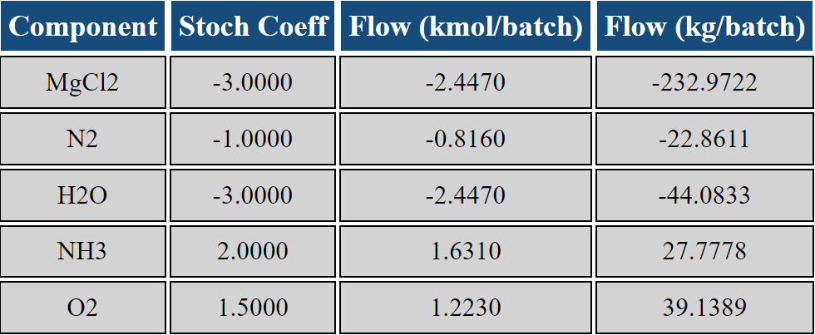
Steady State Material Balance (mtpd)
Non Steady State Material Balance (mtpd)

Slide 14
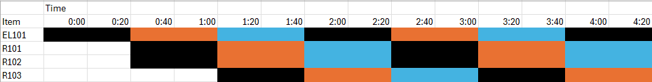
Gantt Chart

Slide 15
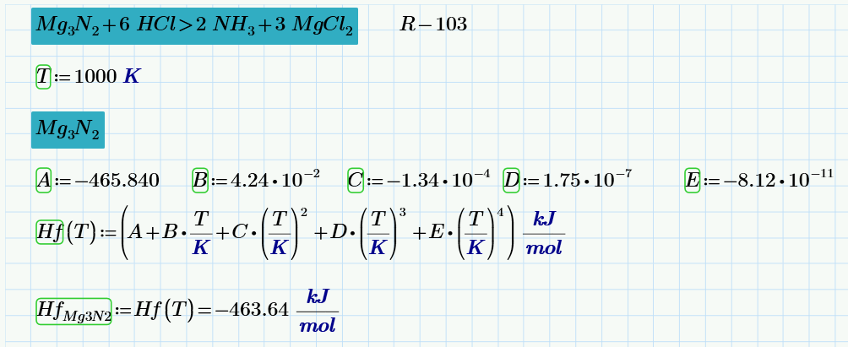
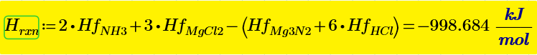
Heat of formation for each component in reaction
Heat of reaction

Slide 16
Process is exothermic overall
Assume 60% transfer of exothermic heat to endothermic unit operations
Efficient in heat integration can substantially enhance return on investment.
Unit | Reagents | Products | Heat of Reaction (kJ/mol)
EL-101 | MgCl2 | Mg + Cl2 | 631.15
R-101 | Cl2 + H2O | 2 HCl + 1.5 O2 | 122.315
R-102 | 3 Mg + N2 | Mg3N2 | -467.5
R-103 | Mg3N2 + 6 HCl | 2 NH3 | -998.684

Slide 17
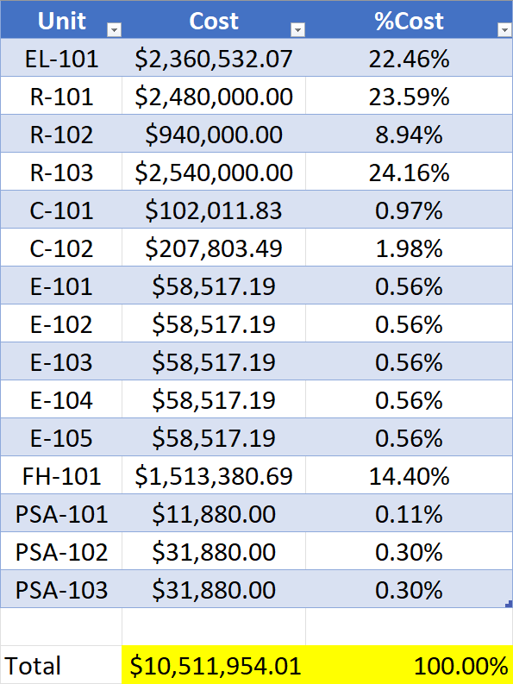
Capital Cost
per Unit
Notes:
Get rid of sheets of math. Do 1 table.

Slide 18
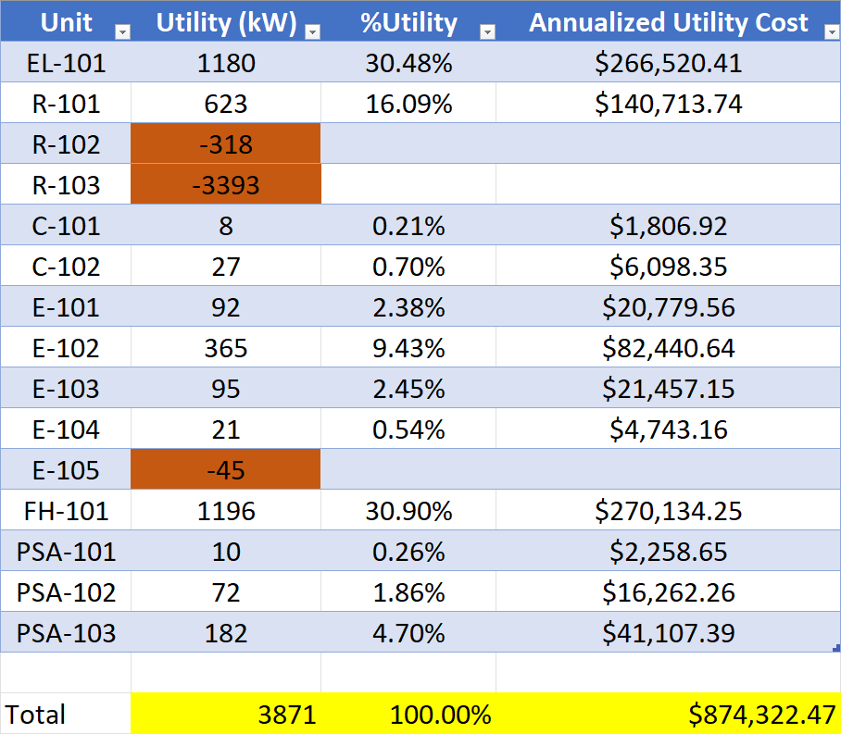
Utility Cost
per Unit

Slide 19
Overall Utility
>5x cheaper to operate at steady state than startup per hour
Assumes 14 startup days and 360 operational days
Process State | kW | Stream Factor | Cost ($/hr) | Cost ($/year)
Startup | 2785 | 0.002 | 72.4 | 1,013
Steady State | 558 | .99 | 14.5 | 125,851

Slide 20
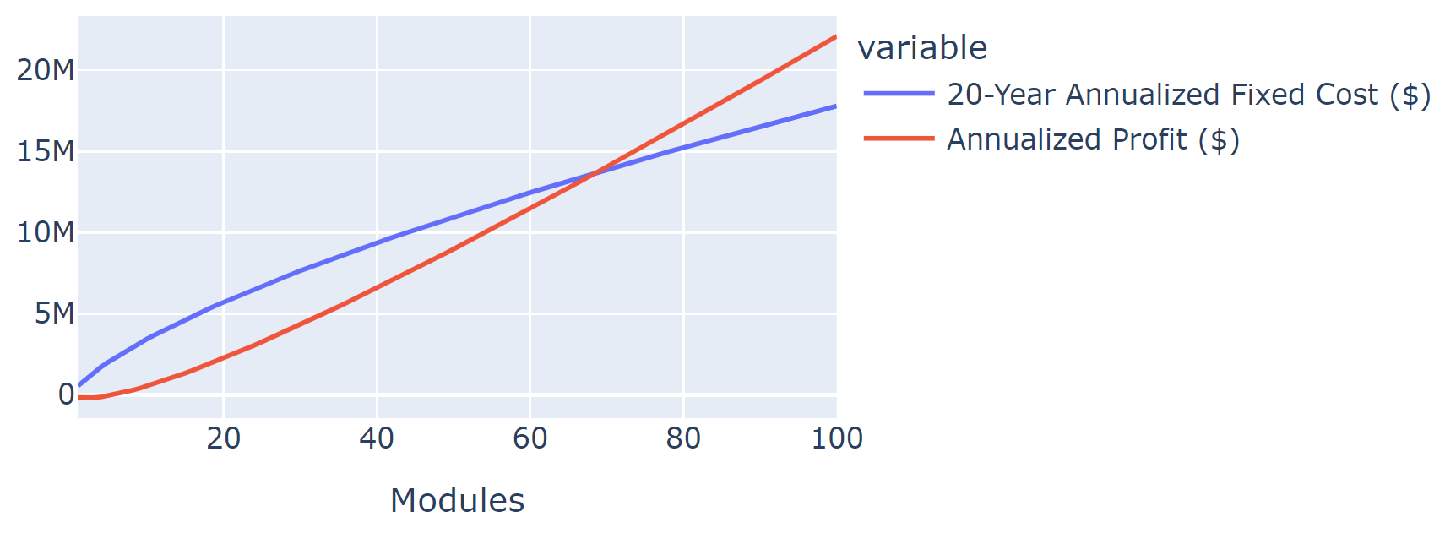
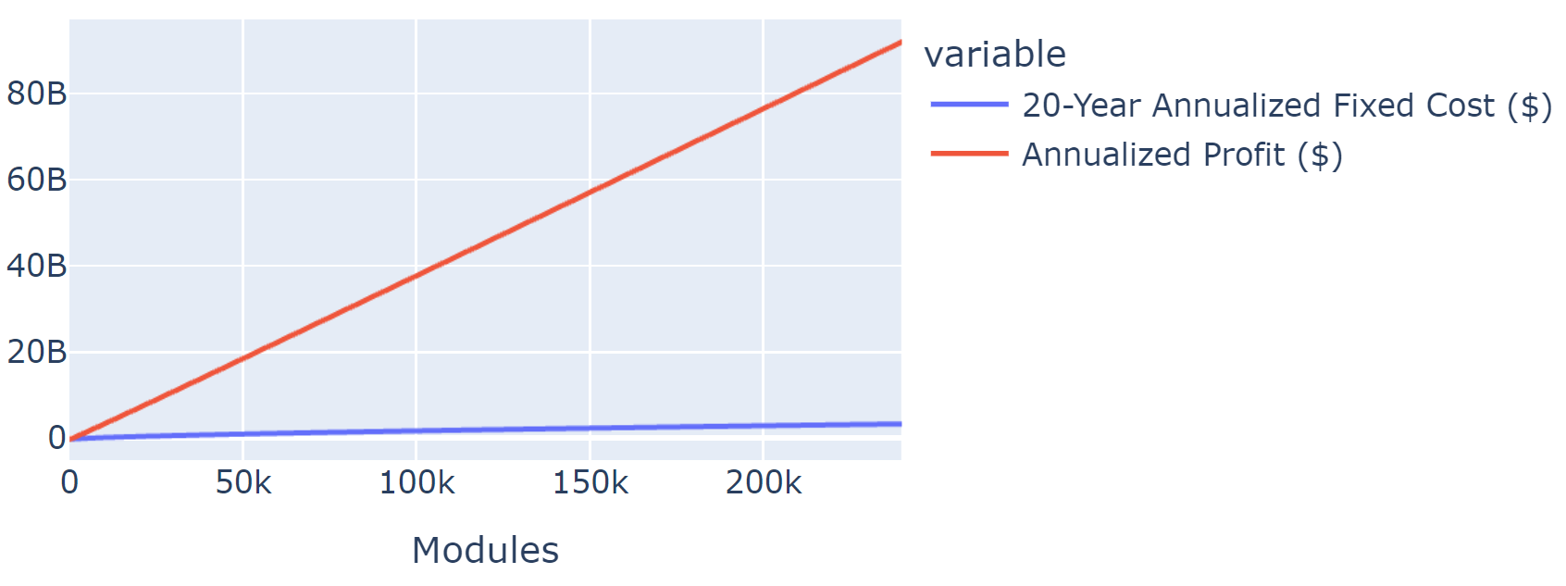
100% Market share of world ammonia production at 240k units
Profitable on first year at 70 modules

Slide 21

Economy of Mass Production

Slide 22


Cash Flow Table
50,000 modules (2,000 plants)
Produced: 36 million mtpy
Demand: 170 million mtpy
Market grows by 7% per year
21% current global market share
Columns with units of dollars in billions
Summary Table

Slide 23


Slide 24
Conclusions / Recommendations
Current techno economic analysis shows that this process can be profitable in first year at 70 modules, each producing 2 metric tonnes per day
Return on investment scales significantly with number of modules
Current generation individual modules are not outright profitable when looking at discounted cash flows
Large ammonia consumers transporting over large distances, may produce ammonia cheaper on-site than buying and transporting
Producing ammonia on-site insulates company from supply/demand changes

Slide 25
Future work
Pilot scale - Collect experimental data on process
Optimize operating pressures vs. capital/utility
Optimize conversion for target flow
Optimize revenue (product flow rate) vs. capital cost
Build and optimize urea module add-on
Integrate utility usage (even design) of heat exchangers, pumps, compressors for gas and liquid mixtures in simulator
Heat integration can significantly improve financial performance

